Slide 1

12. Introduction to Sunnah
(Kinds of Hadith)
Course Instructor
Islamic Studies:
Mufti Muhammad Omer Rafiq

Slide 2
Composition of Hadith
It is widely known among Muslims all over the world that any specific wording of the Messenger ﷺ of Allah SWT on a given topic or theme of subject is known as a “Hadith”. It is obligatory upon every disciple of Islam to know, act upon and spread the Proverbs of Rasulullah ﷺ as these are the words full of wisdom which result in one`s success both in this world and in the hereafter. Hadith, in general is composed of three basic components which are given below:
Matn/Content: It is the main passage which is the actual centre of attraction for the reader. It normally tells about the right way of actions in different circumstances of life.

Slide 3
Isnad/Sequence of Reporters: A series of correspondents through which Hadith has spread.
Taraf/Introductory Text: The earlier portion of main substance which acts as a groundwork for further lesson present in the Saying. It usually acts as a reference towards the deeds or personality of the Holy Prophet ﷺ.
These are the necessary three constituents which need to be present in any text for naming it as a Hadith

Slide 4
Categorization of Hadith
The taxonomy of the Prophetic (PBUH) axioms has been very carefully devised according to different sets of classifications along with their further kinds. Following are the five basic arrangements of Ahadiths on the basis of particular grounds:
According to reference to a particular Authority
According to the links of Isnad
According to a number of reporters
According to nature of Matn and Isnad
According to Authenticity of Correspondents
Now let us briefly discuss these classes of Hadith one by one:

Slide 5
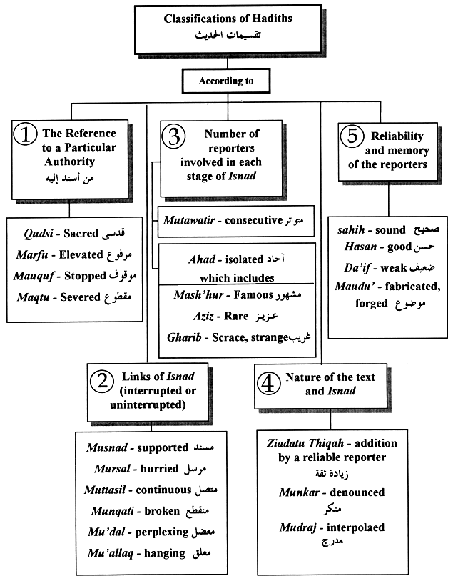

Slide 6
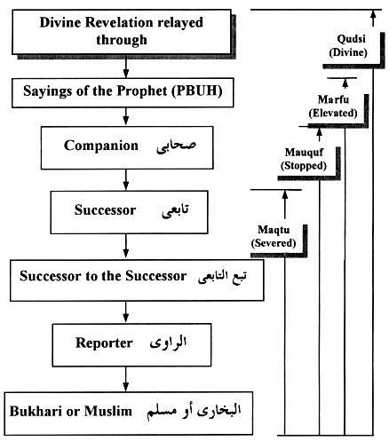

Slide 7
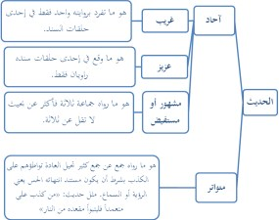

Slide 8
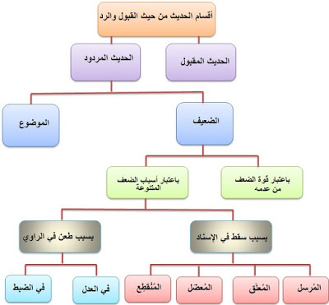

Slide 9
https://www.youtube.com/watch?v=ot5bmOu2yB0

Slide 10
i) According to Reference to a Particular Authority
Qudsi: meaning “Divine”. It is a Heavenly text which was directly sent upon the Holy Prophet (PBUH), Who passed it on to His followers Himself.
الصوم لي و أنا أجزا به قال رسول اللہ ﷺ قال اللہ تعالی:
Marfu`: meaning “Elevated”. It has got very important status in Islam as it was directly heard from the Messenger (PBUH) of God Himself by His companions and was brought forward.
Mauquf: meaning “Stopped”. It is a kind of command which was directly given by Rasulullah (PBUH) to His cohorts who forwarded it.
Maqtu`: meaning “Severed”. It is a form of Instruction which is plainly described by Successor in his own words.

Slide 11
ii) According to the links of Isnad
Hadith is further divided into six groups under this category:
Musnad: meaning “Supported”. Isnad being reported by a well known companion of the Holy Prophet (PBUH) although final narrator might not be with Him at that time.
Muttasil: meaning “Continuous”. The one with undisturbed Isnad relating back to rightful friend or its heir.
Mursal: meaning “Hurried”. It missed a connection between the storyteller and the Messenger (PBUH).
Munqati`: meaning “Broken”. Hadith with a link being absent before it reaches the Successor of the actual narrator.
Mu`adal: meaning “Perplexing”. The one in which narrator misses multiple reported in an order in Isnad of the Hadith.
Mu`allaq: meaning “Hanging”. It fails to spot the complete Isnad of the Hadith.

Slide 12
iii) According to a number of reporters
It is divided into two more sub-groups:
Mutawatir: meaning “Consecutive”. Hadith being reported such a large number of rightful companions that it is agreed upon as authentic.
من كذّب علي متعمد فليتبوأ مقعده في النار
Ahad: meaning “Isolated”. The one which has been narrated by a countable number of people.
It has been further categorized into three sub-types:

Slide 13
Mash’hur: meaning “Famous”. Hadith which is related by more than two individuals.
ان اللہ لا یقبض العلم انتزاعا ینتزعہ من العباد ولکن یقبض العلم بقبض العلماء حتی اذالم یبق عالمااتخذالناس روسا جُھّالا فسئلوافافتوابغیر علم فضلواواضلوا۔(بخاری،مسلم
Aziz: meaning “Rare yet Strong”. The one having only two reporters in its Isnad.
”لَايُؤْمِنُ أَحَدُكُمْ حَتَّى أَكُونَ أَحَبَّ إِلَيْهِ مِنْ وَلَدِهِ وَوَالِدِهِ وَالنَّاسِ أَجْمَعِينَ”
Gharib: meaning “Strange”. Saying of Holy Prophet (PBUH) with only one narrator in its Isnad.
الْإِيمَانُ بِضْعٌ وَسَبْعُونَ أَفْضَلُهَا لَاإِلَهَ إِلَّااللَّهُ وَأَدْنَاهَا إِمَاطَةُ الْأذَی عَنْ الطَّرِيقِ

Slide 14
iv) According to nature of Matn and Isnad
It is split into two major kinds:
Munkar: meaning “Denounced”. A Hadith belonging to a weak reporter.
Mudraj: meaning “Interpolated”. The one having some adding up of words to the authentic Hadith by its narrator.

Slide 15
v) According to Authenticity of Correspondents
It has the following three categories:
Sahih: meaning “Sound”. A hadith reported by a trustworthy reporter known for his truthfulness, knowledge, correct way of narrations etc.
سمعت رسول اللہ ﷺ قرافی المغرب بالطور (بخاری
Hasan: meaning “Good”. The one whose reporters are know and is clear-cut.
قال رسول اللہ ﷺ ان ابواب الجنۃ تحت ظلال السیوف (ترمذی
Da`if: meaning “Weak”. A hadith ranking under that of Hasan because of failing to address the Isnad properly.
Maudu`: meaning “Fabricated”. Hadith having wording opposite to the confirmed Prophetic (PBUH) traditions.
سراج امتی ابوحنیفۃ موضوع (تذکرۃ الموضوعات لملاعلی القاری ص ۱۱۱

Slide 16
In short, Hadith is an integral part of Islamic teachings through which Muslims all over the world get insight about many aspects of life. Therefore, one must know about its different kinds so as to become able to distinguish the authentic ones from the rest which have weak links in its key constituents.

